Slide 1
Bank Marketing Analysis
Quicken Loans Case Study Analysis
By Rucha Kadam

Slide 2
About the Dataset
The data is about clients contacted via telemarketing of a Bank Term Deposit of a European Banking Institution.
The column “response” represents if the client subscribed to the product
Information of a predictive model used is provided.
Notes:
Marketing spending is important because to optimize marketing strategies for increasing effectiveness of product, customer sat and smarter product design and save employee time
This project is imp for establishing a target customer profile for future marketing plans and predicting cust response to tele marketing
By analyzing customer features, such as demographics and transaction history, the bank will be able to predict customer saving behaviours and identify which type of customers is more likely to make term deposits.
reducing undesirable advertisements for certain customers.
The process by which companies create value for customers and build strong customer relationships in order to capture value from customers in return.
Kotler and Armstrong (2010).

Slide 3
Goal
Establish a target customer profile for future marketing plans based on combinations of Customer and Campaign variables.
Evaluate performance of deployed model and suggest if the model needs to be replaced.

Slide 4
Why is this important?
Increasing effectiveness of product, customer satisfaction, smarter product design and save employee time
Provides insights for higher management to evaluate campaign performance and make decisions on defining new targets for sales team and customizing strategies
To formulate further hypothesis for model building

Slide 5
What to address?
Which opportunities are overlooked?
Which type of features to avoid when marketing this product to client?

Slide 6
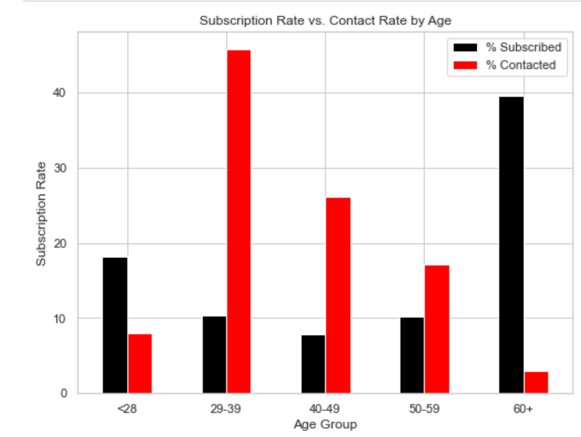
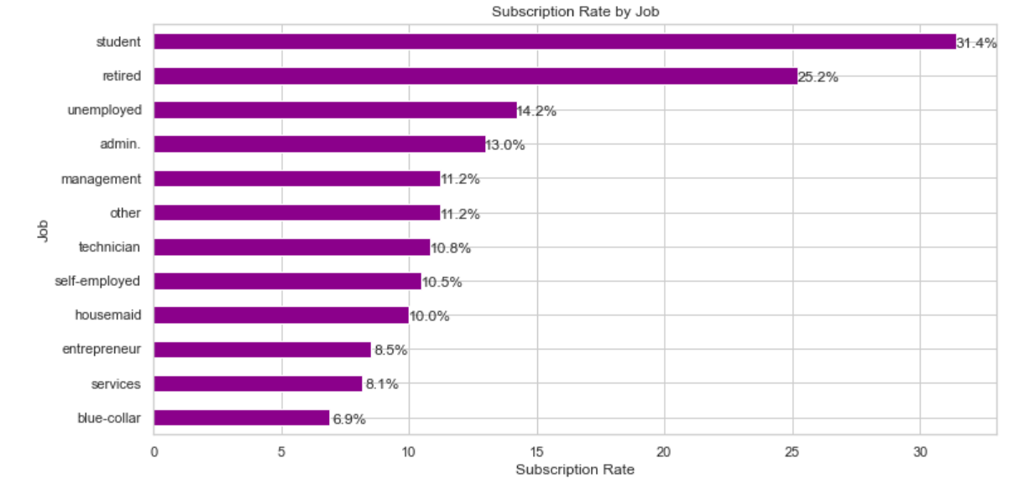
Analysis of Client Features and response

Slide 7
Analysis of Client Features and response
Observations:
Age-Response graph indicates that clients with a age of 60+ have the highest subscription rate at 39%. About 18% of the subscriptions came from the clients aged between 18 to 29. More than 50% of the subscriptions are contributed by the youngest and the eldest clients.
Job – Response graph agrees with the Age-Response graph showing Students and Retired clients response positive, followed by unemployed and white collar jobs
Insights:
Target the youngest and the oldest instead of the middle-aged
Target students, retired, unemployed clients more than clients who are admin or blue collared.

Slide 8
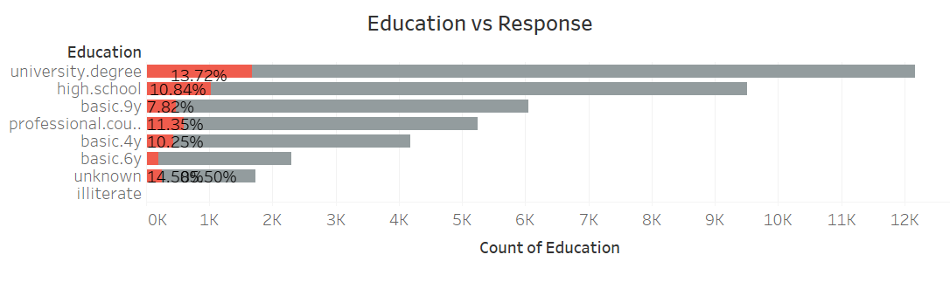
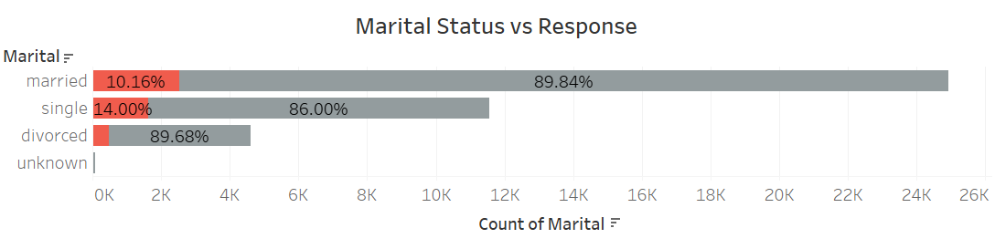
Analysis of Client Features and response

Slide 9
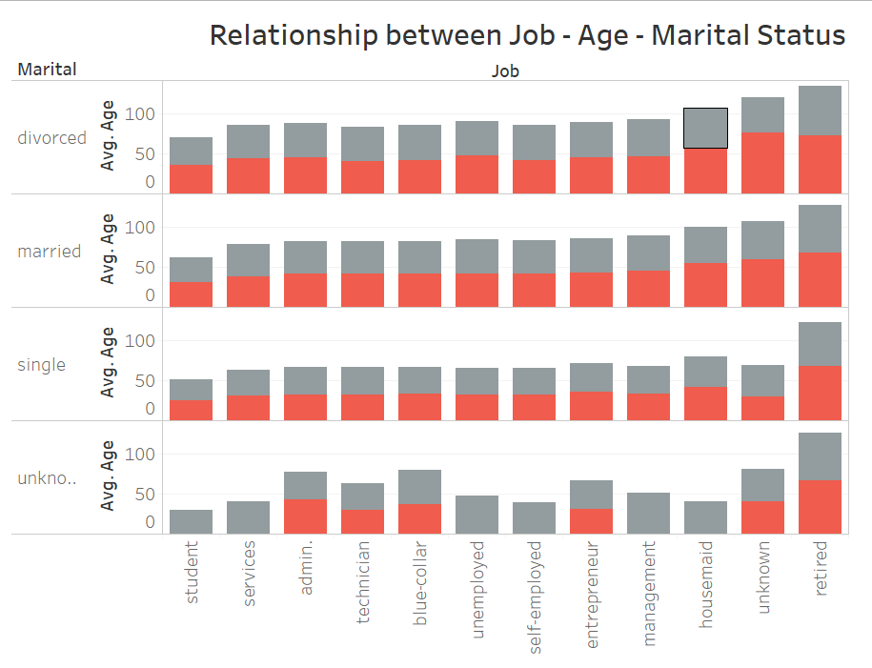

Slide 10
Analysis of Client Features and response
Observations: In the education-response graph, university degree, professional course and unknown have higher conversion.
In marital – response graph, single clients followed by married have high conversion rate. Divorced clients show lowest conversion.
Insights: Target clients with higher level education, need to find what unknown indicate.
Target clients who are single, with second priority married client

Slide 11
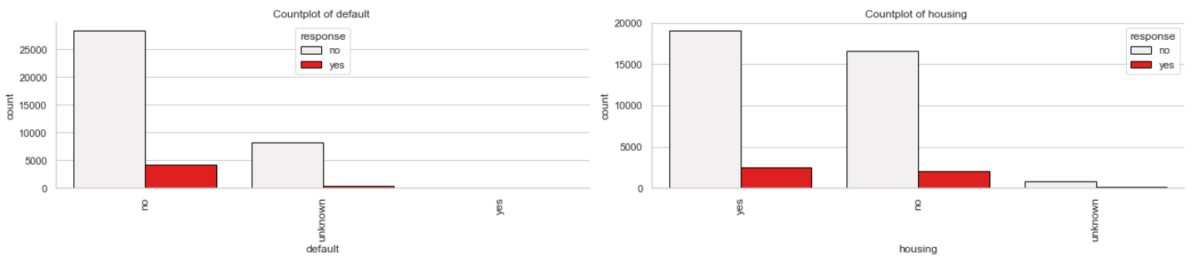
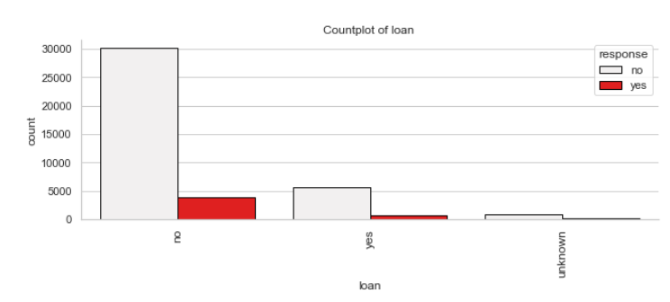
Analysis of Client Credit and Response

Slide 12
Analysis of Client Credit and Response
Observations:
The default and housing graph does not show a strong relationship with response.
The personal loan graph indicates that clients without existing personal loans were contacted more than the ones with. But the percentage of positive response is equal in both cases.
Insights:
Clients with personal loans must be contacted and equal number of clients with personal loans must be contacted to compare and support the observation that clients with PL have a higher chance of investing in FD.

Slide 13
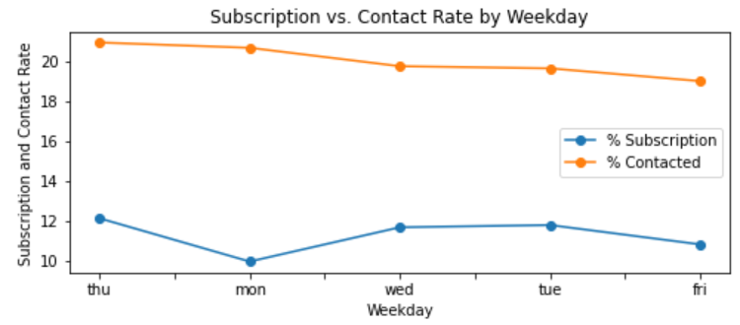
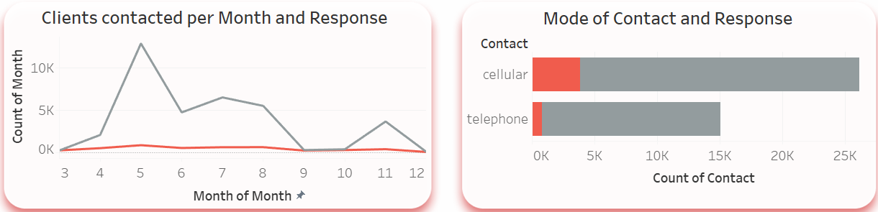
Analysis of Campaign Contact history and Response

Slide 14
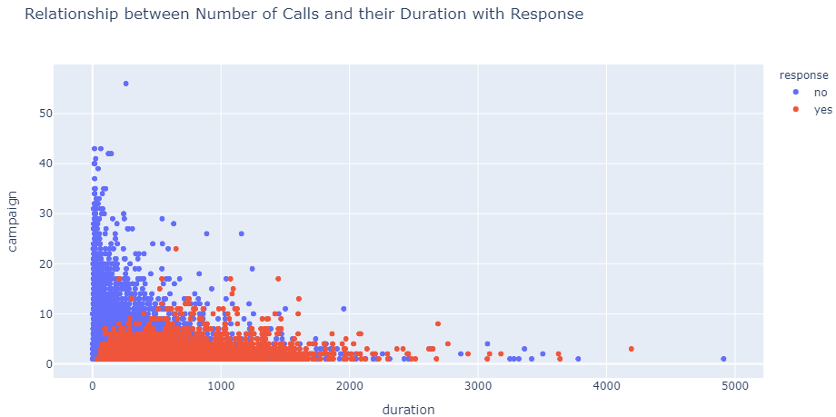
Analysis of Campaign Contact history and Response

Slide 15
Analysis of Campaign Contact history and Response
Observations:
Contacts per month chart displays the bank’s contact rate in each month as well as clients’ response rate in each month.
Contacts per day chart displays response on Tuesday and Wednesday is more as compared to Monday where its low even when contact made are max of week.
In the duration vs contact chart, we can see from the plot, “yes” clients and “no” clients are forming two relatively separate clusters. Compared to “no” clients”, “yes” clients were contacted by fewer times and had longer call duration. More importantly, after five campaign calls, clients are more likely to reject the term deposit unless the duration is high. Most “yes” clients were approached by less than 10 times.
Insights:
Initiate the telemarketing campaign in spring or summer. To improve the marketing campaign, the bank should consider initiating the telemarketing campaign in spring and summer when the subscription rate tends to be higher.
Contacts should be made preferably on Tuesday, Wednesday and Thursday.
Productivity of marketing team is maximum on Monday and least on Friday.
Response of clients contacted on cellphone is more positive than telephone.
This suggests that the bank should resist calling a client for more than six times, which can be disturbing and increase dissatisfaction.

Slide 16
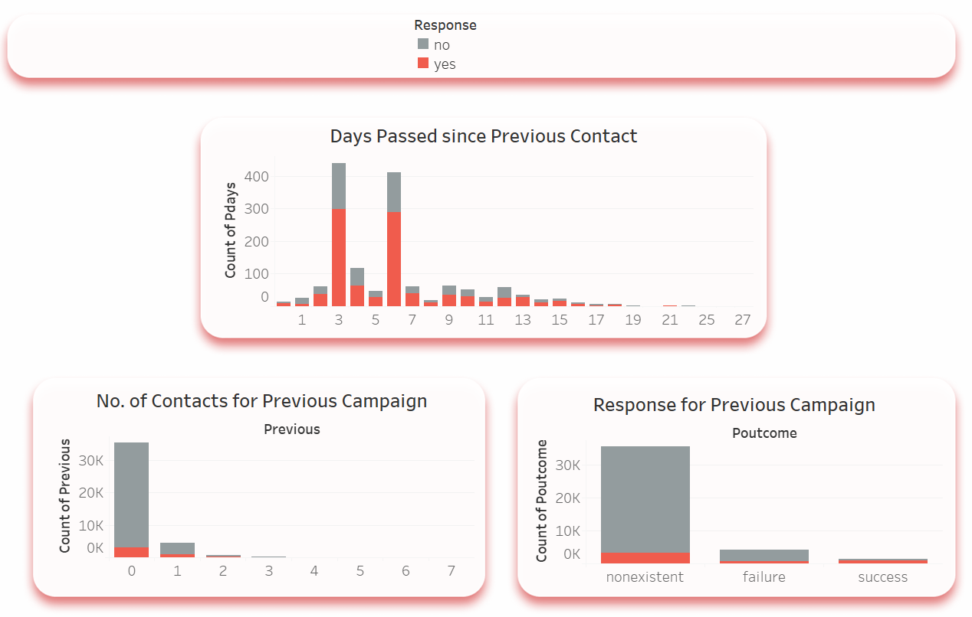
Analysis of Previous Campaign and Response

Slide 17
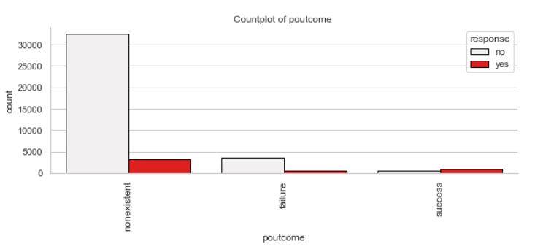
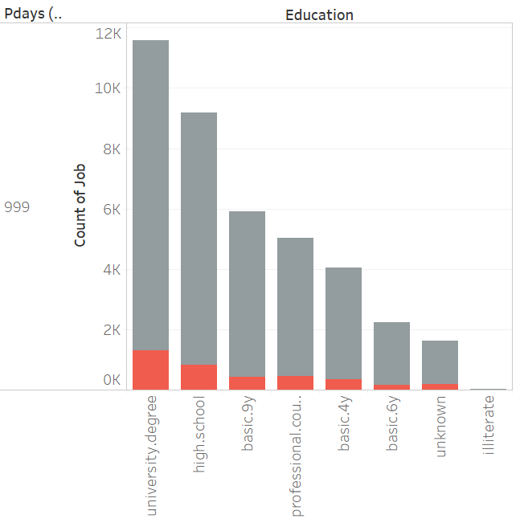
Analysis of Previous Campaign and Response

Slide 18
Analysis of Previous Campaign and Response
Observation:
Pdays - Number of days that passed by after the client was last contacted from a previous campaign and
Previous - Number of contacts performed before this campaign and for this client have no effect on response.
Poutcome: Outcome of the previous marketing campaign shows clients who enrolled/interested in previous campaign had a positive response.
Insights:
Clients who have shown interest in previous products should be contacted more.
New clients should be focused more having university or highschool level education for higher success rate.

Slide 19
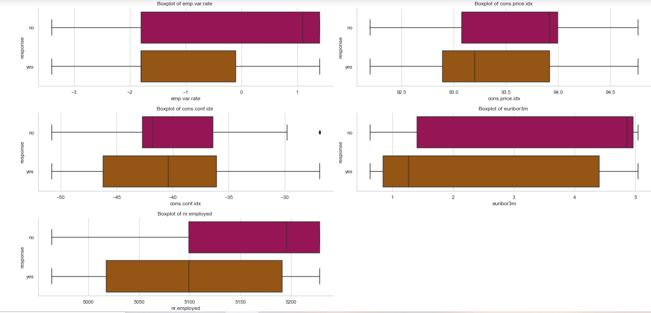
Analysis of Socio-Economic conditions with Response

Slide 20
Analysis of Socio-Economic conditions with Response
Observations:
employment variation rate shows clients were interested in term deposit when the rate was lower than when higher.
In consumer price index clients show more interest when CPI is between 92.8 – 93.8
Consumer confidence is negative
Insights:
When economy is in inflation, clients tend to invest in term deposit.
When CPI is high, term deposit rate is low and clients tend to invest.
When CCI is negative clients tend to invest.
When euribor 3 month rate is over 4.9, client invests in term deposit.

Slide 21
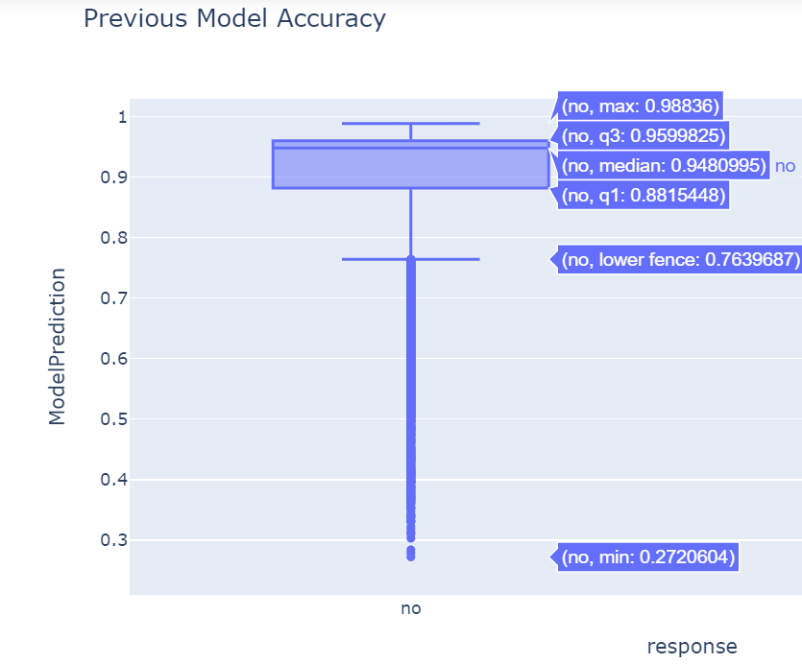
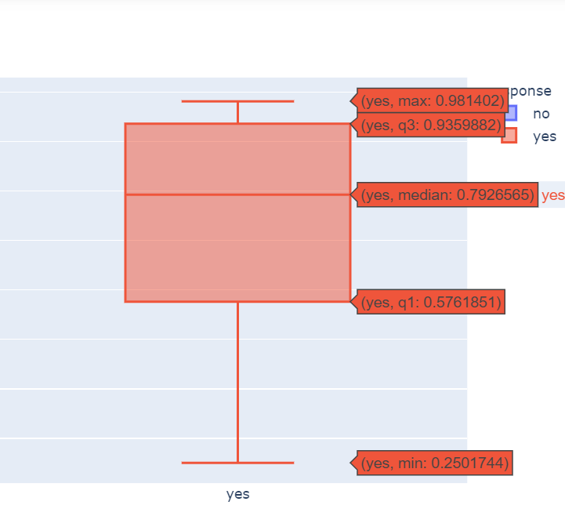
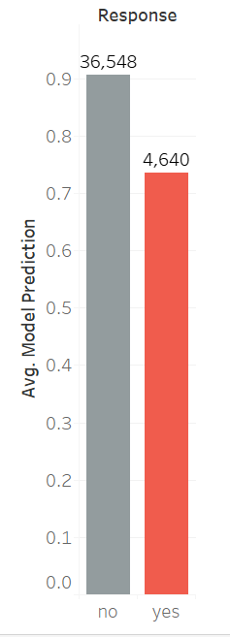
Is the Current Model Accurate?

Slide 22
Is the Current Model Accurate?
For Response: No
The interquartile range here is 88% to 96%
For Response: Yes
The interquartile range here is 94% to 57%
Majority of the responses received were negative and the response column shows a higher possibility of positive response for FD when the real life its negative.
The model needs to be changed.

Slide 23
Conclusion
Target Customer Profile
Feature 1: age < 30 or age > 60
Feature 2: students or retired people
Feature 3: marital status is Single
Feature 4: Higher education level
Recommendations
Timing: March and September have highest positive response, marketing should be started in fall and spring.
Mid week days have a higher positive response.
Response is more positive when contacted over a cell phone
Calls made to the client should be limited to a total of 6
Clients who have subcribed for previous product have higher chances of subscribing to this product
Prediction model is not accurate and must be replaced.

Slide 24
Thank you!

Slide 25
Useful Links
Python Code:
Tableau visualizations: https://public.tableau.com/profile/rucha.kadam#!/vizhome/td_16147590965510/Clientfeatures

